Slide 1
Inheritance
In JAVA
Name: Jannatul Firdous Samiya
ID: 222400024
Department of CSE

Slide 2

Introduction
Inheritance in Java is a mechanism in which one object acquires all the properties and behaviors of a parent object. It is an important part of OOPs (Object Oriented programming system). It is a fundamental concept in object-oriented programming.
Inheritance represents the IS-A relationship which is also known as a parent-child relationship.

Slide 3
Example
Vehicle
For example: Bike ,Car, Bus these are vehicles. That’s why the child of vehicle are bike, car, bus and Vehicle is the parent of this object.
Bike, Car, Bus

Slide 4
Java Inheritance
The importance of Inheritance in Java program is code reusability. We can reuse the function of the parent class at child class.
Subclass and Superclass are in Java inheritance.
In Java we use extends keyword for Java Inheritance.
Method Overriding is achievable only through Inheritance.

Slide 5

Syntax
class Subclass-name extends Superclass-name
{
//methods and fields
}

Slide 6
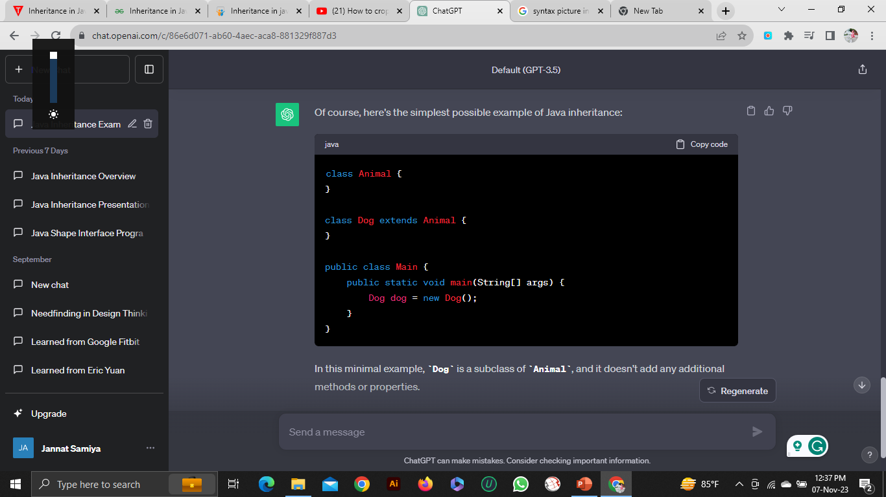
Simple Program
Animal
Parent class
Dog
Child class

Slide 7
Types of Inheritance
Multiple
Single
Note: In Java Multiple Inheritance is not supported
Inheritance
Multilevel
Hybrid
Hierarchical

Slide 8
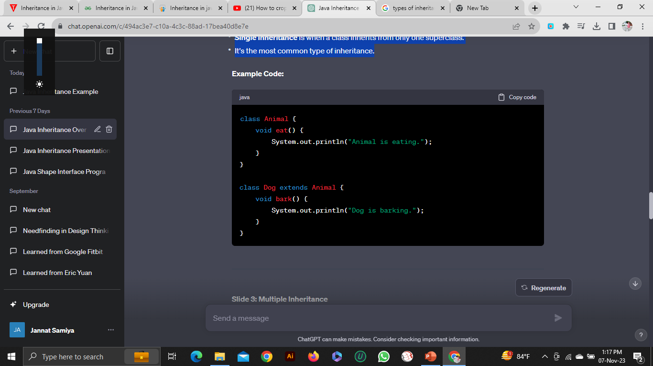
Single Inheritance
Single Inheritance is when a class inherits from only one superclass.
It's the most common type of inheritance.

Slide 9
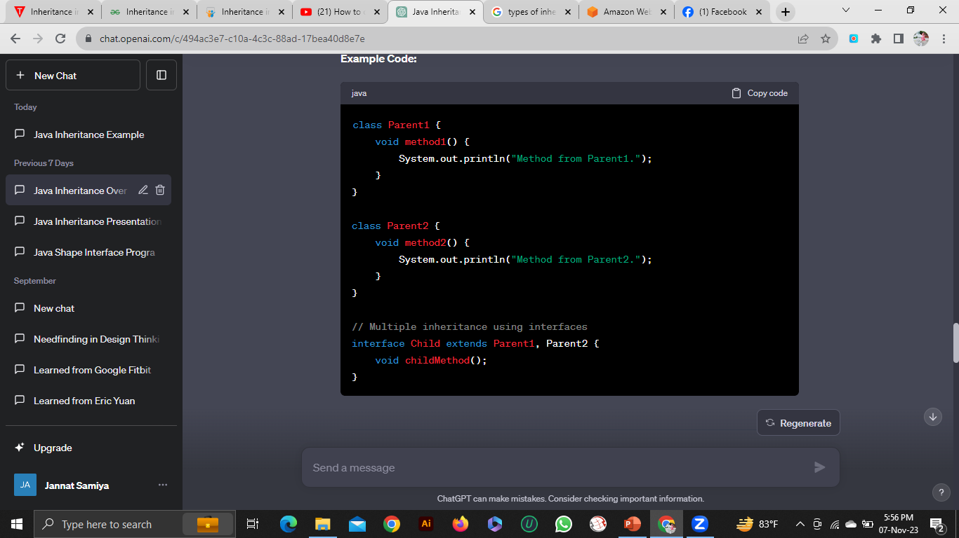
Multiple Inheritance
Multiple Inheritance is when a class inherits from multiple super classes.
Java doesn't support multiple inheritance directly to avoid the "diamond problem."

Slide 10
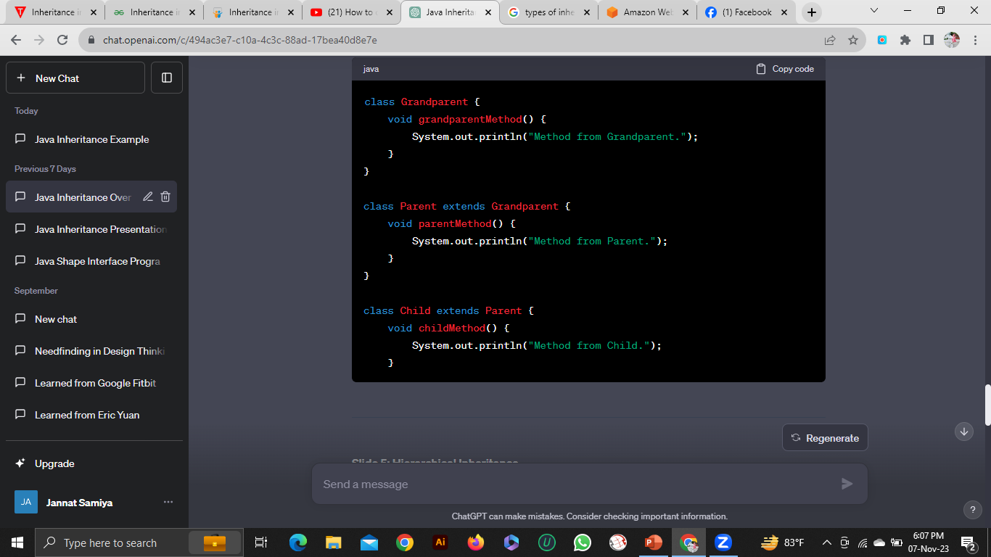
Multilevel Inheritance
Multilevel Inheritance is when a class inherits from another class, which in turn inherits from another class.
This creates a chain of inheritance.

Slide 11
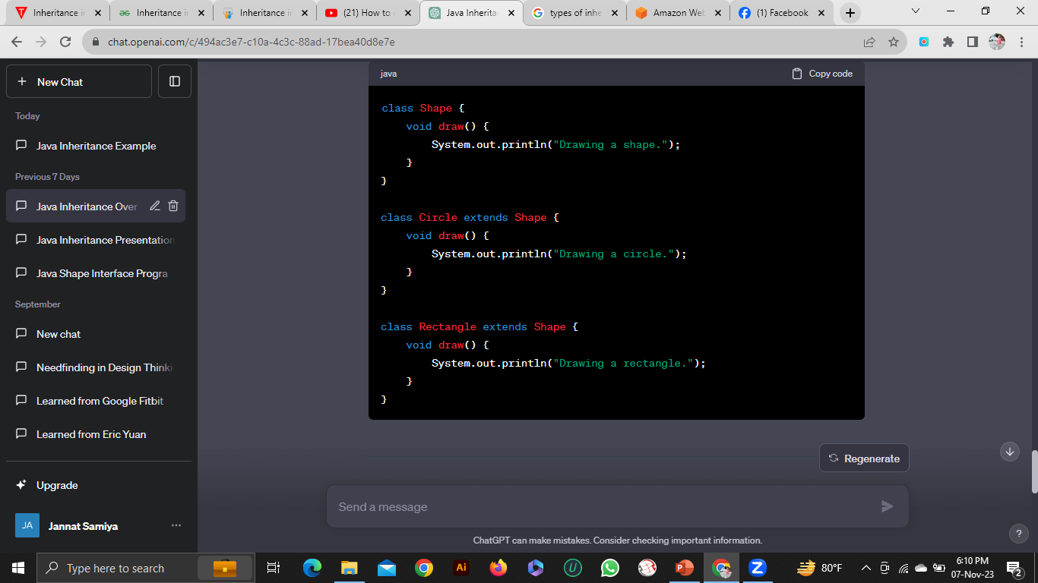
Hierarchical Inheritance
Hierarchical Inheritance is when multiple classes inherit from a single superclass.
Multiple subclasses share a common base class.

Slide 12
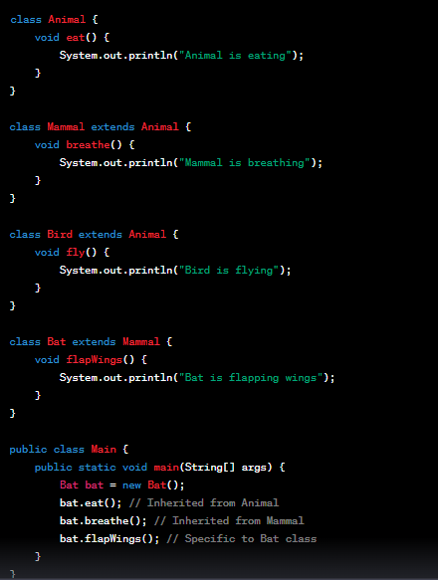
Hybrid Inheritance
Hybrid inheritance in Java is a combination of multiple inheritance and hierarchical inheritance.
In multiple inheritance, a class can inherit from more than one class, and in hierarchical inheritance, multiple classes can inherit from a single base class. Hybrid inheritance allows for a combination of these two types of inheritance.

Slide 13


